Slide 1
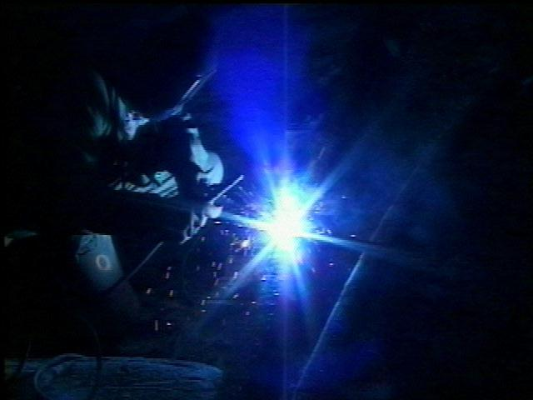
"Underground
Electrical
Safety"

Slide 2
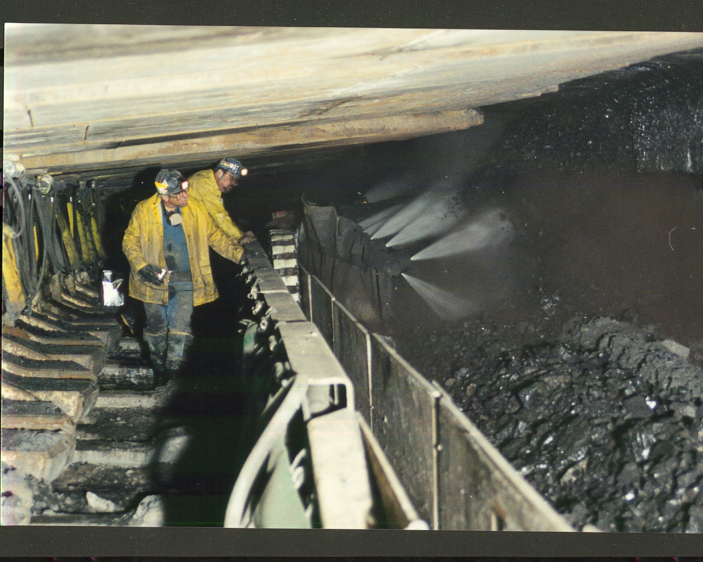
The two types of electricity used in mining are:
“AC” or alternating current and
“DC” or direct current

Slide 3
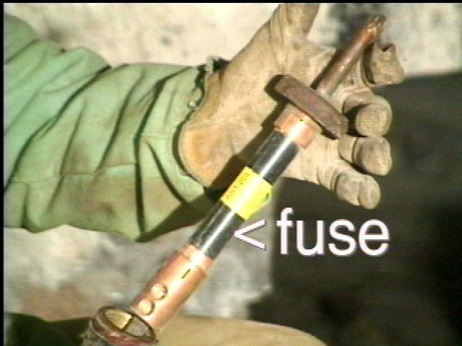
Why must caution be used when operating or repairing electrical equipment?
Failure to exercise caution may result in injury.

Slide 4
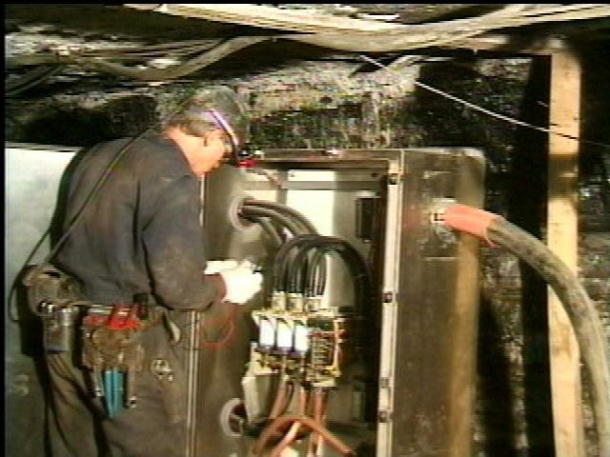
When performing electrical work, always use the proper protective equipment, such as:
safety glasses, protective gloves, and a properly rated meter.

Slide 5
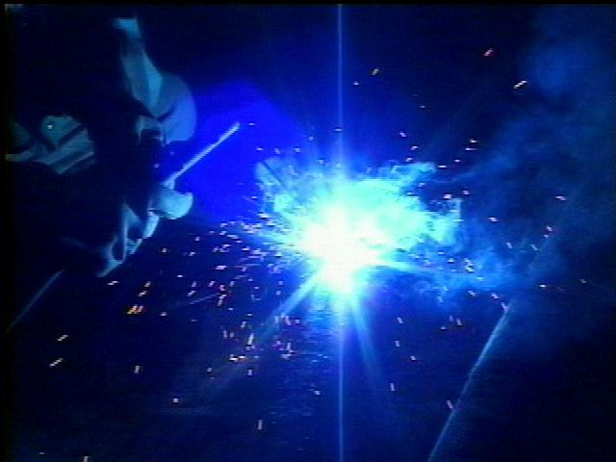
What types of accidents can occur while working around electricity?
Electrical shock, electrical burns, and flash burns.

Slide 6
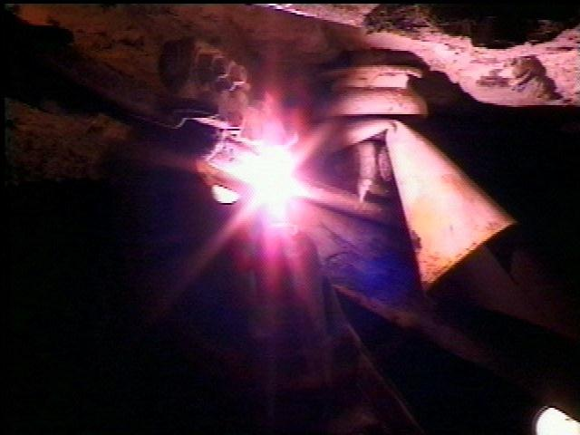
What are some of the other hazards that can result from electricity?
Electricity can be an ignition source for mine fires and explosions.

Slide 7
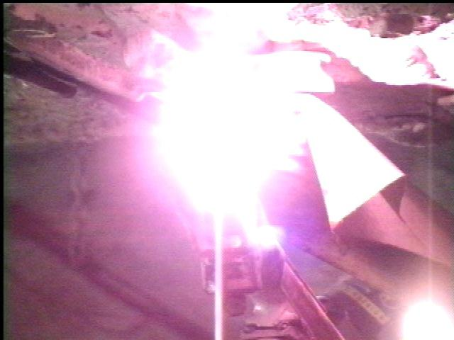
What dangers are posed by electrical arcs?
Arcs can: - generate heat and cause fires - cause burns or eye damage - reach temperatures of 10,000 degrees

Slide 8
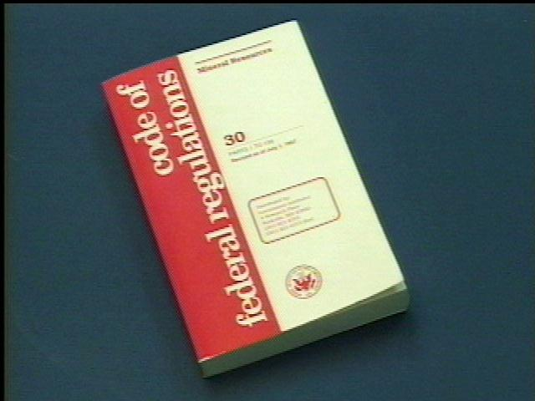
Do any regulations exist regarding electrical hazards?
State and Federal regulations, as well as company policies, have been designed to guard against electrical hazards in the mining industry.

Slide 9
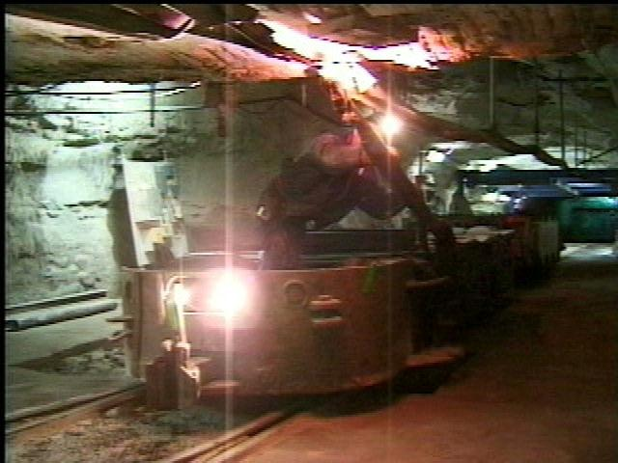
Who is exposed to the hazards of electricity?
All miners are exposed to electricity.
Do not take electricity for granted.

Slide 10
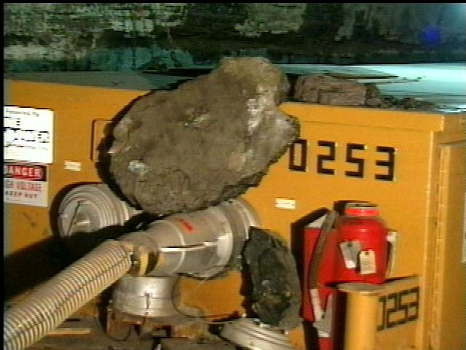
What dangerous conditions can occur as a result of poor roof conditions?
Falling rock may damage an electrical cable or component.

Slide 11
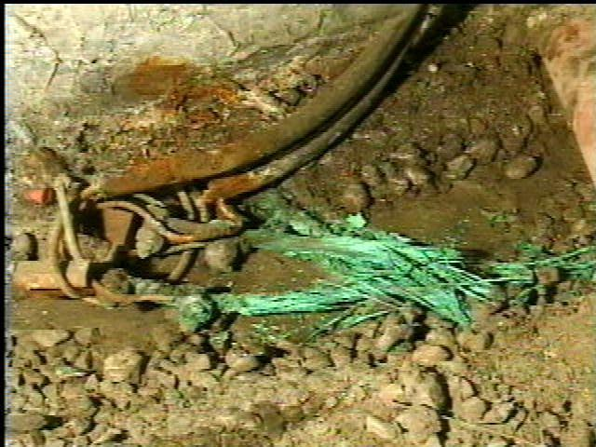
What hazards can wet conditions contribute to?
Wet conditions may corrode metal electrical components and cause their failure.

Slide 12
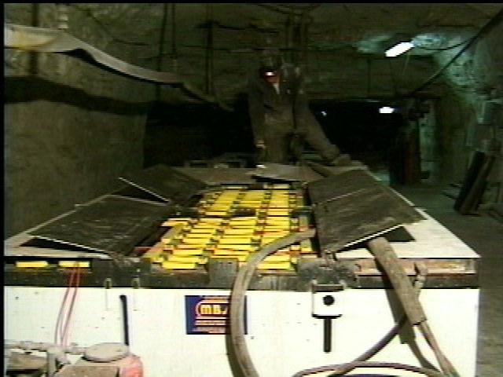
Why must you exercise caution and use proper protective equipment when working with batteries?
Batteries could explode and cause injury or could ignite and cause fires

Slide 13
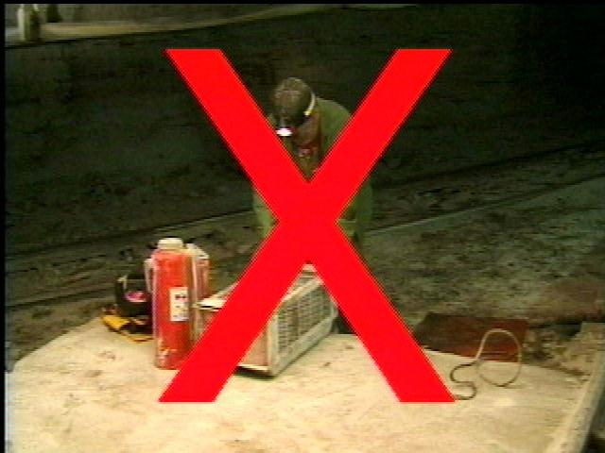
Be alert and knowledgeable of the hazards of electricity.
Never touch any electrical component until you are sure it is deenergized.

Slide 14
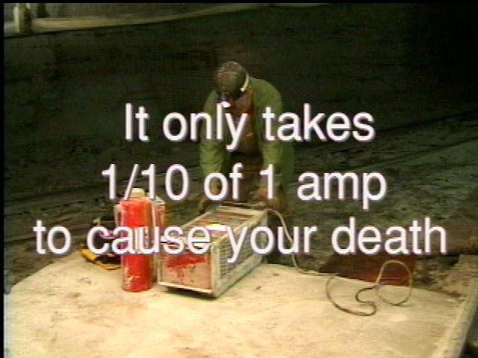

Slide 15
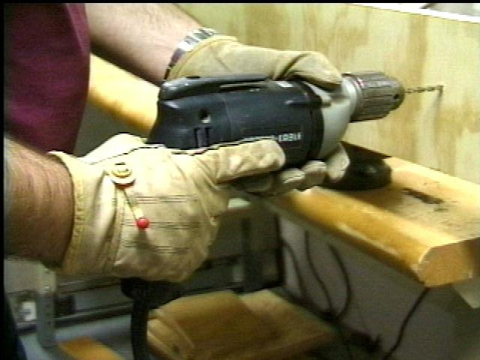
What amounts of voltage should be considered dangerous?
All amounts. The most common source of electrical shock is 110 volts.

Slide 16
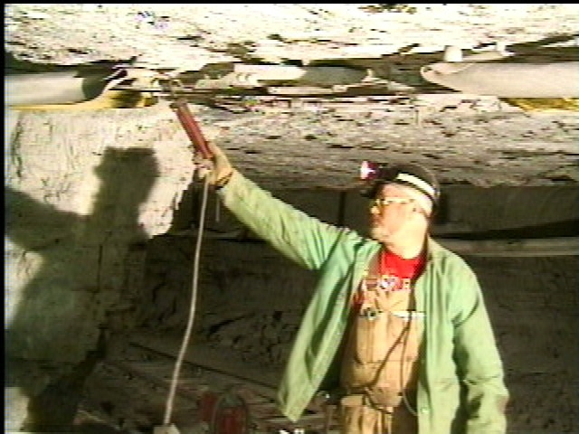
What should you do if you find a potentially dangerous condition?
Remove it from service immediately and report it to the appropriate person.

Slide 17
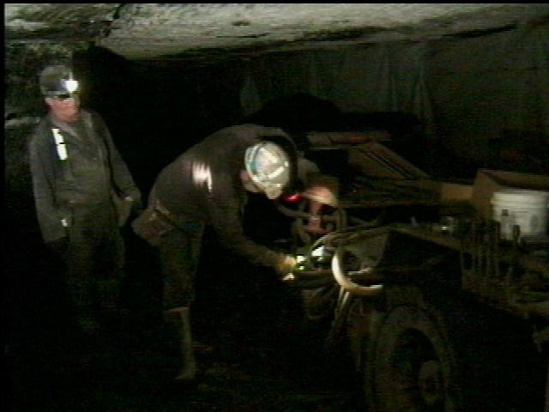
Why must you use caution when working in low lighting?
Hazards are much harder to see.

Slide 18
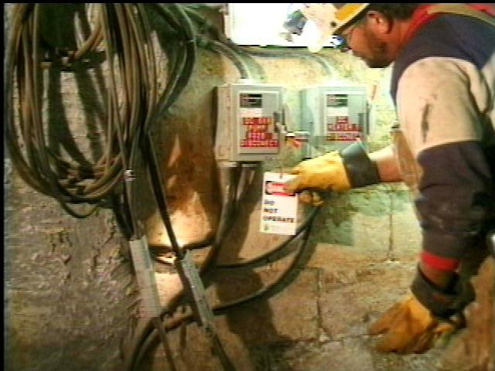
No electrical work can be performed until:
the electrical circuit is knocked, locked, and tagged.

Slide 19
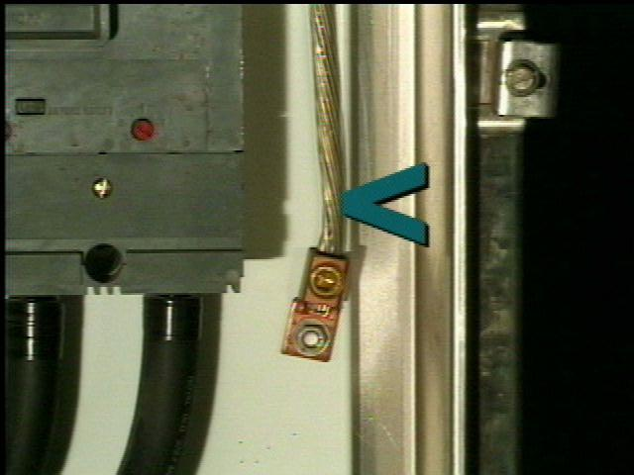
Always make certain the frame ground is properly connected.

Slide 20
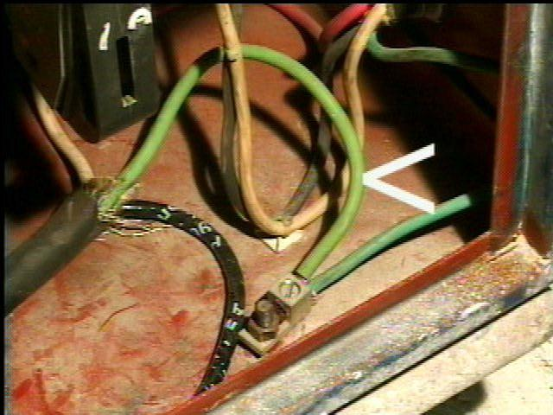
Metal components that can be energized by the failure of insulation, or by contact with energized parts, shall be grounded by approved methods.

Slide 21
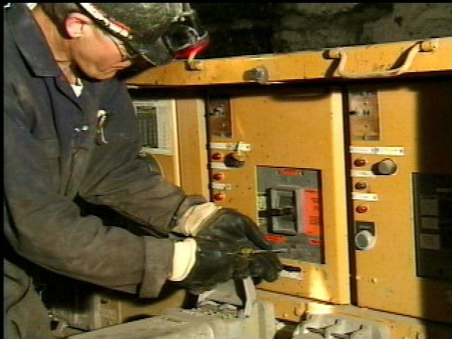
No electrical work shall be performed except by a qualified person.
Circuit breakers and disconnects shall be marked for identification.
Circuit breaking devices or proper fuses, shall be installed to protect against short circuit and overloads.

Slide 22
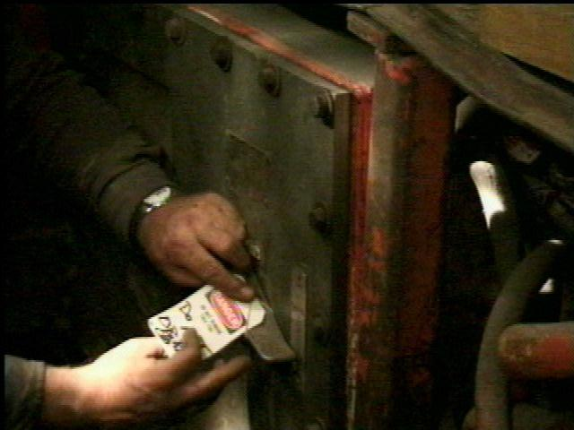
All power circuits and electrical equipment shall be deenergized before work is performed, except for troubleshooting or testing.
When a potentially dangerous condition is found on electric equipment, it shall be removed from service until it is repaired.

Slide 23
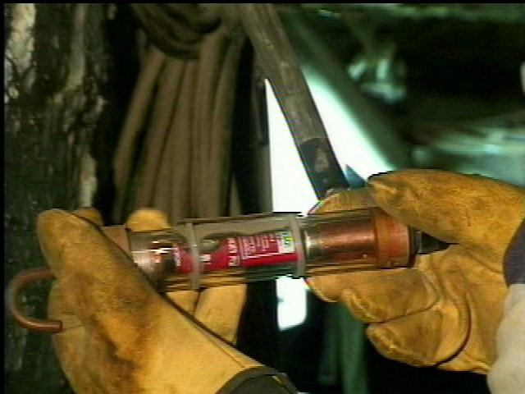
Disconnecting devices shall be locked and tagged out.
All electrical equipment shall be examined, tested, properly maintained, and results recorded as required.

Slide 24
Produced by American Electric Power in cooperation with the Mine Safety and Health Administration (MSHA)
Special Thanks To:
Donna Bowen Timothy Martin
David Grubb William Mathews
Bruce Hann Randal Riddle
Robert Klatt Lance Sogan
Raymond Lieving Charles Wood
Employees at Southern Ohio Coal Co. and Windsor Coal Co.

Slide 25
Technical Advisors: Paul Fernatt Robert Teichman
MSHA Advisor: Ronald Sidwell
UMWA - Local 1886 Advisors: Paul Walker Clarence Williams
Narration: Randy Callihan

